Slide 1
Name : Kesavan.K
NM.ID : au730321243012
RegNo : 730321243012
Dept : B.Tech AI and DS
Year : 3rd-year
College : Builders Engineering College

Slide 2

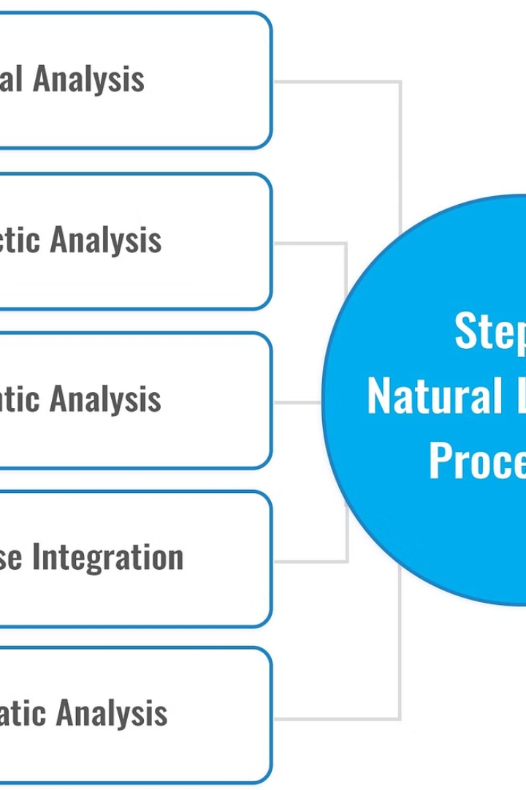
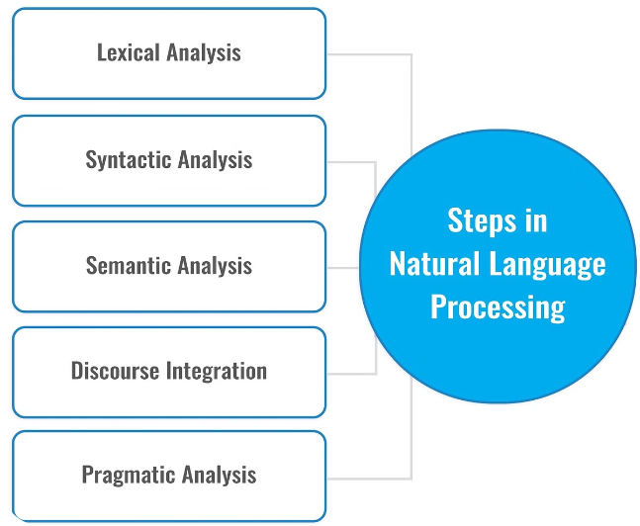
Next Word Predictor Project
An introduction to the next word predictor project, aiming to develop a predictive text algorithm based on language models and natural language processing techniques.

Slide 3
Purpose and Goals of the Next Word Predictor
Enhance Text Input Experience
Improve Writing Efficiency
The main goal is to improve the user experience of typing by accurately predicting the next word.
To increase writing speed and reduce errors, the predictor aims to suggest contextually relevant words in real-time.
Expand Vocabulary Coverage
Provide a wide range of word suggestions to accommodate different writing styles and linguistic preferences.

Slide 4
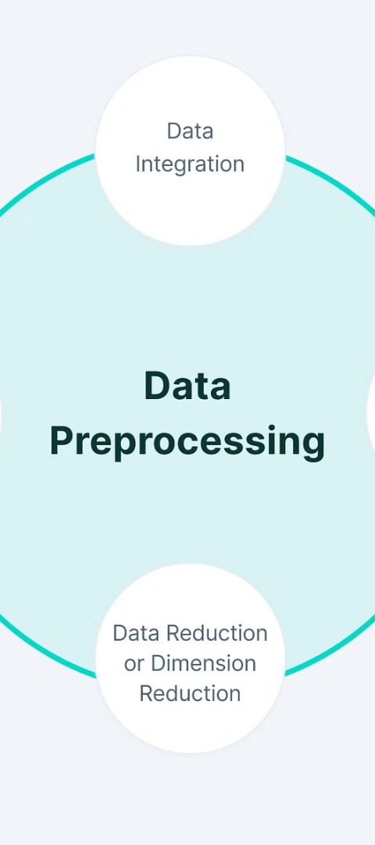
Data Collection and Preprocessing
1
Data Gathering
Collecting a diverse range of text data from various sources such as books, articles, and websites.
2
Data Cleaning
Removing irrelevant characters, punctuation, and special symbols to prepare the text for analysis.
3
Data Tokenization
Breaking down the cleaned text into individual words or tokens to facilitate further processing.

Slide 5
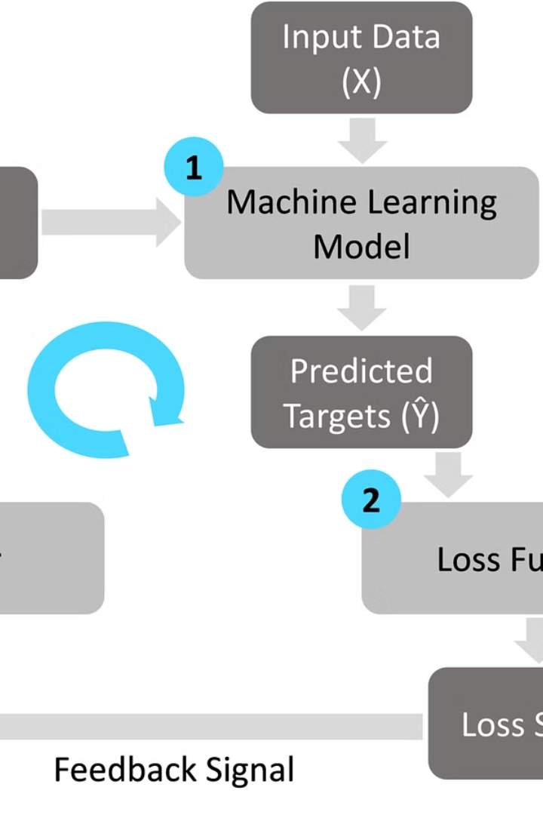
Model Selection and Training
When selecting a model, consider factors like complexity, interpretability, and performance. Train the chosen model using a diverse dataset with proper validation techniques.
Utilize techniques such as cross-validation and hyperparameter tuning to ensure the model's robustness and generalization capabilities.

Slide 6
Evaluation metrics and results
Evaluation Metrics
Model Results
Accuracy
89%
Precision
91%
Recall
87%
F1 Score
88%

Slide 7

User Interface Design
When designing the user interface for the next word predictor, our focus is on creating a seamless and intuitive experience for users. We prioritize clean and minimalistic design, ensuring that the predictive text feature is easily accessible and user-friendly.
By incorporating user feedback and conducting usability testing, we aim to optimize the interface to maximize user engagement and satisfaction with the prediction suggestions.

Slide 8



Integration with Different Platforms
Web Integration
Mobile Integration
API Integration
Implement the model on web-based platforms for easy access and usage.
Develop a mobile app to integrate the predictive model for on-the-go use.
Provide an API for seamless integration with other software applications.

Slide 9
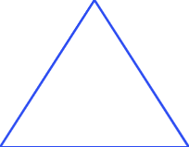


Future improvements and enhancements
Enhancing User Experience
1
Streamlining the interface for better usability
Integrating AI Algorithms
2
Implementing advanced machine learning models
Expanding Vocabulary Coverage
3
Increasing the range of predicted words
In the future, the next word predictor project aims to enhance user experience by streamlining the interface for better usability. It also plans to integrate AI algorithms to implement advanced machine learning models. Additionally, expanding the vocabulary coverage for increased word prediction accuracy is on the agenda.

Slide 10

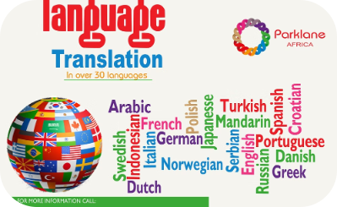
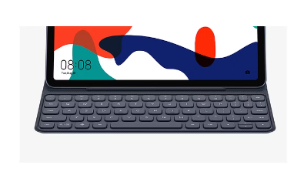
Project impact and potential applications
Medical Research Breakthroughs
Language Translation Advancements
Smart Keyboard Interface
The application of next word prediction algorithms can enhance language translation tools, leading to more accurate and efficient communication across diverse languages.
Next word prediction software can improve user experience and productivity by offering intelligent word suggestions for faster and more natural typing.
Next word predictor technology can aid in medical research by streamlining data analysis and accelerating the discovery of new treatments.

Slide 11

Conclusion and Next Steps
As we conclude this project, the next steps involve deploying the model and gathering user feedback. We will analyze the usage data and continue to refine the prediction accuracy. Additionally, exploring potential collaborations with other language processing projects is an exciting prospect for future enhancements.

